Slide 1
Real World
Attacks
A deep dive into Daam Malware and a simple virus scanner demonstration
By Andrea Zerbe

Slide 2

Introduction
In this presentation I will be reviewing malware and then doing a technical analysis of a current example. The analysis will be a deep dive into some of the technical workings of the Daam Malware. Followed by a demonstration of a simple virus scanner.
Research is the foundation of discovery and innovation.
Notes:
In this presentation I will be reviewing malware and then doing a technical analysis of a current example. The analysis will be a deep dive into some of the technical workings of this current event. Followed by a demonstration of a simple virus scanner. Research is the foundation of discovery and innovation.

Slide 3
Malware Recap

Slide 4

What is Malware Again?
Malware, short for malicious software, is a persistent and insidious threat that cybersecurity professionals constantly strive to combat. It refers to any software or code that is specifically designed to cause harm, exploit vulnerabilities, or gain unauthorized access to computer systems, networks, or devices.
Notes:
Malware, short for malicious software, is a persistent and insidious threat that cybersecurity professionals constantly strive to combat. It refers to any software or code that is specifically designed to cause harm, exploit vulnerabilities, or gain unauthorized access to computer systems, networks, or devices.

Slide 5

How is Malware Delivered?
Malware can be distributed through various methods, such as malicious email attachments, infected websites, compromised software downloads, or even removable devices like USB drives.
Notes:
Malware can be distributed through various methods, such as malicious email attachments, infected websites, compromised software downloads, or even removable devices like USB drives. This is why it's crucial to have good cybersecurity practices, like keeping your software up to date, using strong passwords, being cautious of suspicious links or attachments, and using reputable antivirus or security software to protect against malware.

Slide 6
APK

Slide 7
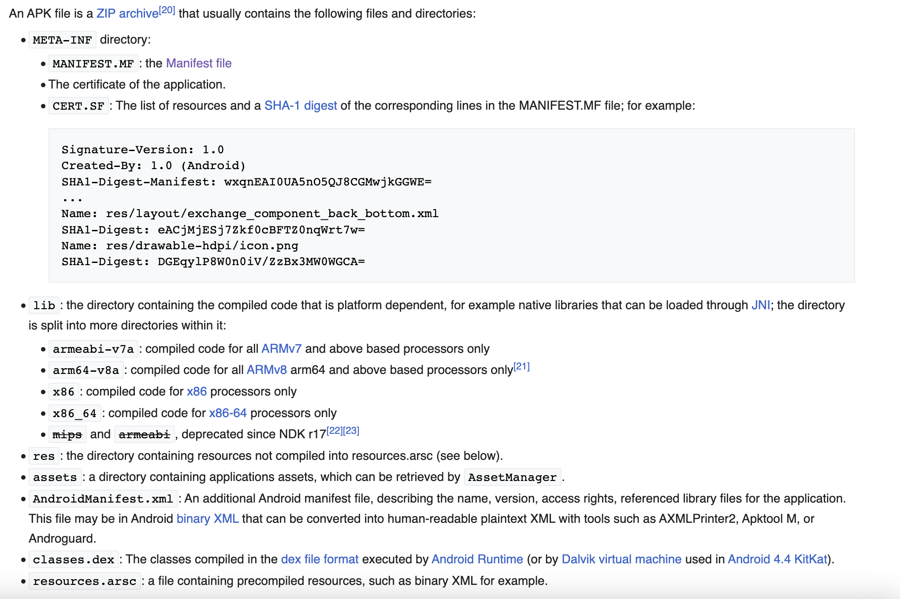
What is an APK?
An APK is an abbreviation for "Android Application Package." It is the file format used to distribute and install applications on Android devices, such as smartphones and tablets. In simpler terms, an APK file is like a package that contains all the necessary files and instructions needed to install and run an app on an Android device.
When you download an app from the Google Play Store or other sources, you are essentially downloading an APK file. This file contains the code, resources like images and sounds, and other files required for the app to function properly. (10)
Notes:
An APK is an abbreviation for "Android Application Package." It is the file format used to distribute and install applications on Android devices, such as smartphones and tablets. In simpler terms, an APK file is like a package that contains all the necessary files and instructions needed to install and run an app on an Android device.
When you download an app from the Google Play Store or other sources, you are essentially downloading an APK file. This file contains the code, resources like images and sounds, and other files required for the app to function properly.
The screenshot on the left is the description of a typical file structure of an APK. You will see some of these file names such as the manifest file, and the classes.dex file later in the technical analysis.

Slide 8
Daam Malware

Slide 9
Daam Malware - Overview
“Daam is a malicious software that possesses the capability to infiltrate Android devices and gain unauthorized access to various sensitive components, including call records, contacts, history, and even the device’s camera.” (1)
Discovered in April 2023 (2)
Notes:
“Daam is a malicious software that possesses the capability to infiltrate Android devices and gain unauthorized access to various sensitive components, including call records, contacts, history, and even the device’s camera.”
Discovered in April 2023

Slide 10
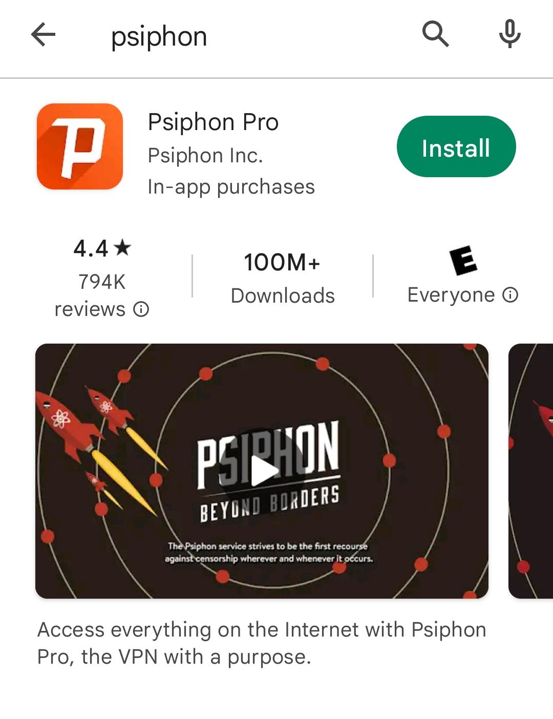
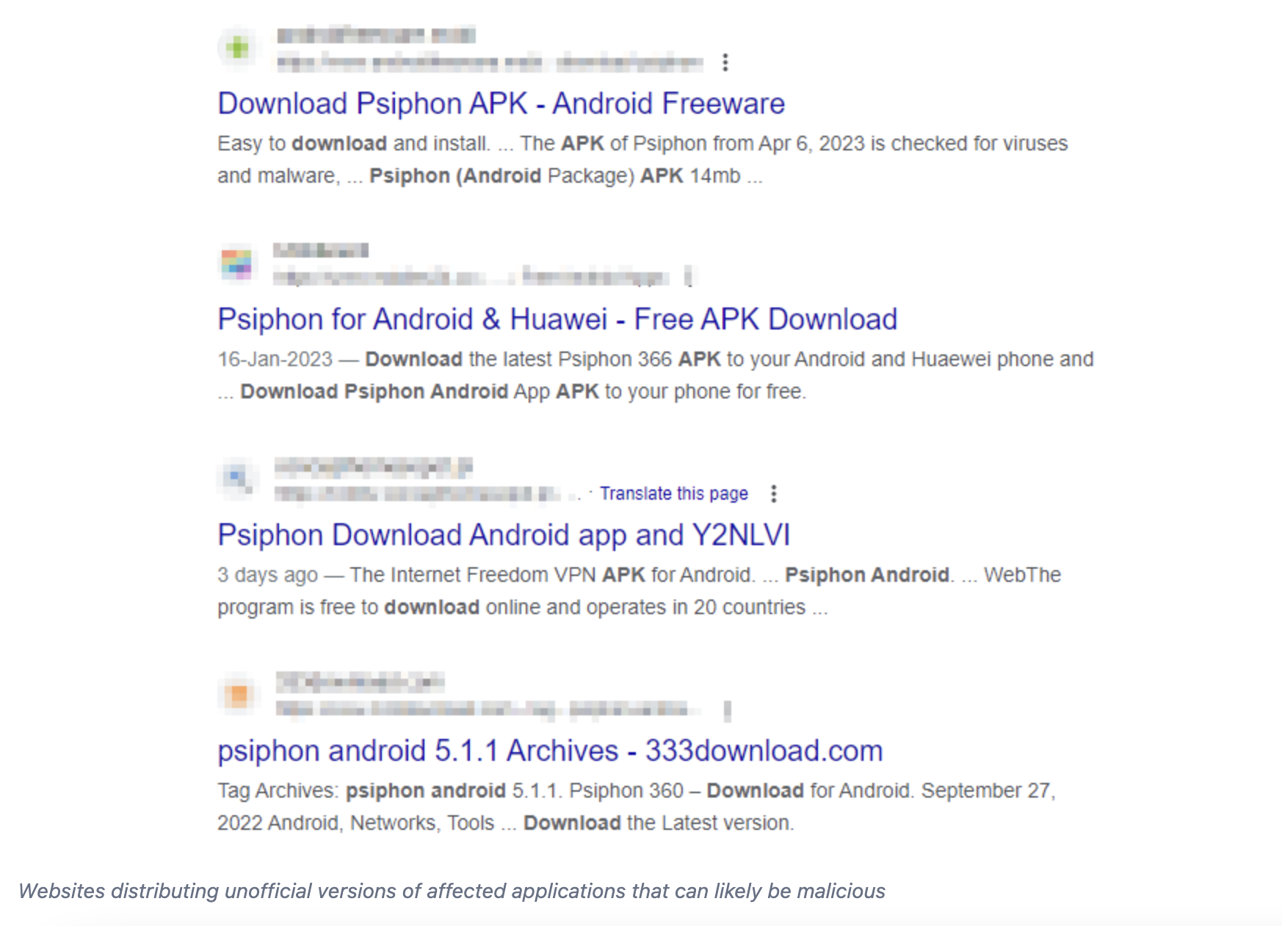
Daam Malware - APK’s
These malicious apps are being sideloaded, meaning that they are being downloaded from a third party site instead of installing them from the official Google Play app store. (8)
The suspected malicious APK’s
Psiphon Client for Android and Windows: “One known app that has been used to deliver the DAAM botnet is Psiphon. Psiphon is a popular app that allows users to bypass internet censorship and access blocked websites. However, cybercriminals have been known to modify the legitimate Psiphon app and distribute it as a trojanized version that includes the DAAM botnet malware.” (7)
Boulders: Boulders is a mobile game.
Currency Pro: Currency Pro is a global currency converter. (3)
(9)
Notes:
These malicious apps are being sideloaded, meaning that they are being downloaded from a third party site instead of installing them from the official Google Play app store.
The suspected malicious APK’s
Psiphon Client for Android and Windows: “One known app that has been used to deliver the DAAM botnet is Psiphon. Psiphon is a popular app that allows users to bypass internet censorship and access blocked websites. However, cybercriminals have been known to modify the legitimate Psiphon app and distribute it as a trojanized version that includes the DAAM botnet malware”. This is a real and legitimate app from the official app store that these malicious actors have modified and made available for download outside of the Google Play store.
Boulders: Boulders is a mobile game.
Currency Pro: Currency Pro is a global currency converter.
On the left there are 2 photos. The top one is depicting a screenshot off my android of the official Psiphon app and the bottom is depicting a screenshot of a google search of the Psiphon app and some of the unofficial sources that may be responsible for distributing the Daam malware.

Slide 11

Daam Malware - Technical Overview
“... the aforementioned three applications are utilizing a common malicious package file named "com.android.callservice". These trojanized applications were being used to distribute the Daam malware.” (3)
Notes:
“... the aforementioned three applications are utilizing a common malicious package file named "com.android.callservice". These trojanized applications were being used to distribute the Daam malware.”

Slide 12
Daam Malware - Permissions
Once the application is installed on the Android device it is granted access to highly sensitive permissions such as;
RECORD_AUDIO - permission to record audio.
<uses-permission android:name="android.permission.RECORD_AUDIO" /> (6)
READ_HISTORY_BOOKMARK - permission to read all web history and bookmarks
<uses-permission android:name="android.permission.READ_HISTORY_BOOKMARK" />
RECEIVE_SMS, READ_SMS, SEND_SMS - permissions to receive, read, and send SMS text messages
<uses-permission android:name="android.permission.RECEIVE_SMS" />
<uses-permission android:name="android.permission.READ_SMS" />
<uses-permission android:name="android.permission.SEND_SMS" />
This is just to list a few, more listed on next slide.
Notes:
Once the application is installed on the Android device it is granted access to highly sensitive permissions such as;
RECORD_AUDIO - permission to record audio.
<uses-permission android:name="android.permission.RECORD_AUDIO" /> (6)
READ_HISTORY_BOOKMARK - permission to read all web history and bookmarks
<uses-permission android:name="android.permission.READ_HISTORY_BOOKMARK" />
RECEIVE_SMS, READ_SMS, SEND_SMS - permissions to receive, read, and send SMS text messages
<uses-permission android:name="android.permission.RECEIVE_SMS" />
<uses-permission android:name="android.permission.READ_SMS" />
<uses-permission android:name="android.permission.SEND_SMS" />
This is just to list a few, more listed on next slide.

Slide 13
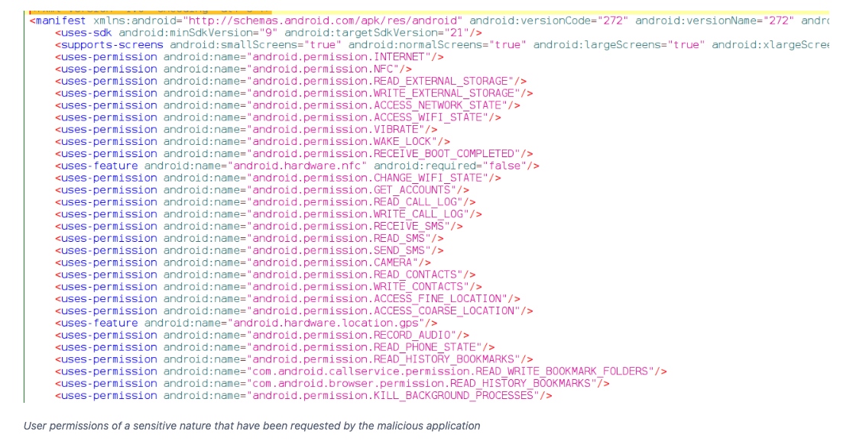
(3)
Notes:
I would like to take a moment to point out some of the other permissions this malware has such as GET_ACCOUNTS, CAMERA, READ_CONTACTS, WRITE_CONTACTS.
To deep dive a bit more into this code, the line `<uses-permission android:name="android.permission.SEND_SMS" />` is an XML declaration that specifies a permission required by an Android application to send SMS (Short Message Service) messages.
When an Android application includes this permission declaration in its manifest file, it indicates that the app needs to send SMS messages from the device. This permission allows the application to initiate and send SMS messages to specific recipients.
With the "SEND_SMS" permission, an application can programmatically compose and send SMS messages on behalf of the user. It can specify the recipient's phone number, the message content, and send the SMS using the device's built-in messaging capabilities.
It's important to note that the "SEND_SMS" permission is a sensitive permission, as it allows an application to send text messages without user interaction.

Slide 14
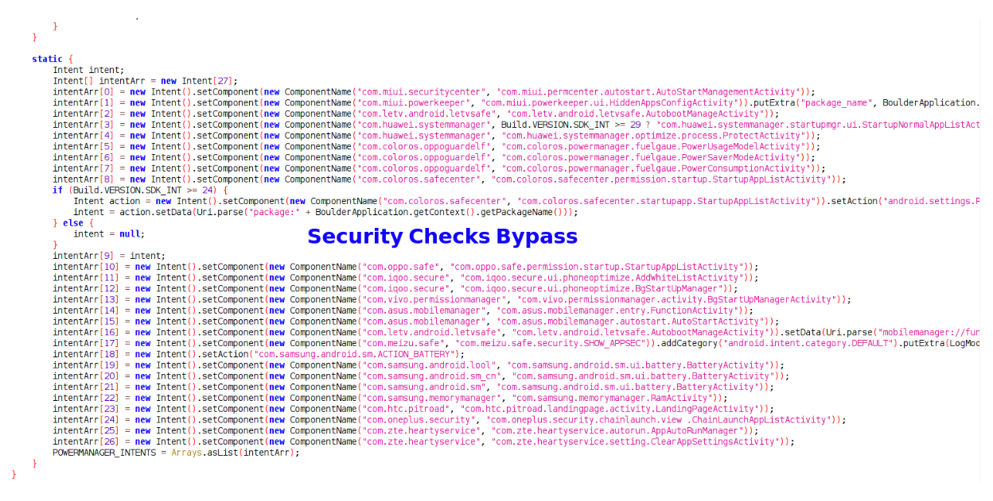
Daam Malware - Security Check Bypassing
Daam malware is sideloaded app. Android devices allow the installation of apps from sources other than the official Google Play Store. Malware authors take advantage of this by distributing their malicious apps through unofficial sources or third-party app stores, where security checks may be less strict or nonexistent.
(3)
Notes:
Daam malware is sideloaded app. Android devices allow the installation of apps from sources other than the official Google Play Store. Malware authors take advantage of this by distributing their malicious apps through unofficial sources or third-party app stores, where security checks may be less strict or nonexistent. Google Play Protect which is the security feature integrated into the official app store can scan sideloaded apps, but from my understanding this malicious app bypasses those security checks as well.

Slide 15
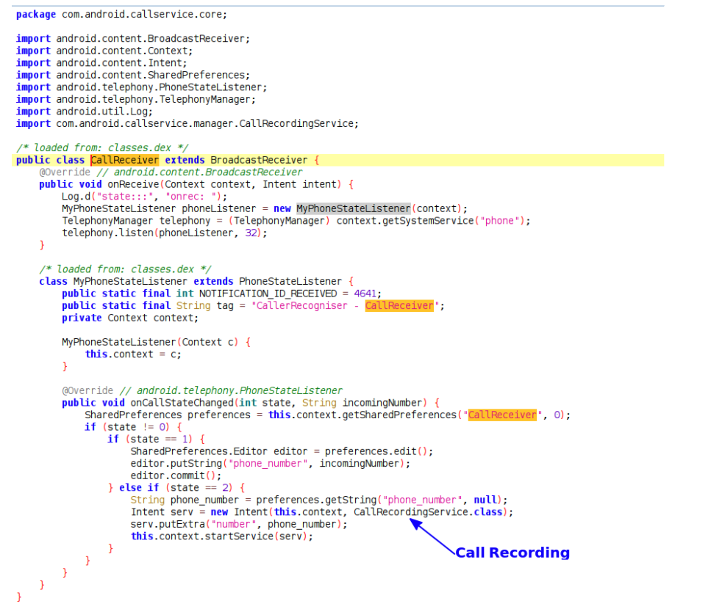
Daam Malware - Recording Audio And Phone/VoIP Calls
This malware has the ability to record any and all calls on the victims device and the transmit them back to the C2 server.
Not only does it monitor the local device, but it also has the ability to monitor and record VoIP calls from other applications such as Whatsapp and Skype. (3)
(3)
Notes:
This malware has the ability to record any and all calls on the victims device and the transmit them back to the C2 server.
Not only does it monitor the local device, but it also has the ability to monitor and record VoIP calls from other applications such as Whatsapp and Skype.

Slide 16
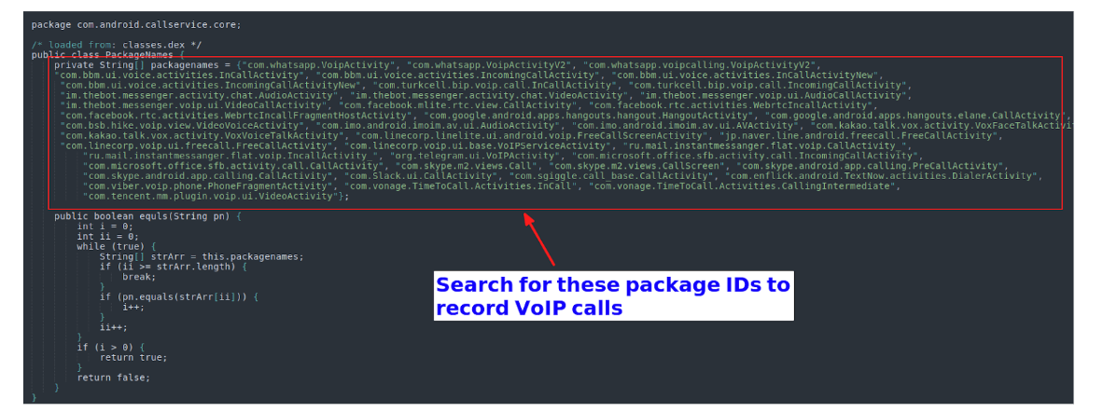
Daam Malware - Recording Audio And Phone/VoIP Calls
(3)
Notes:
This screenshot depicts all the app packages that are also monitored. You will notice it is monitoring WhatsApp, Facebook, Google, Skype, and Slack to name a few.

Slide 17
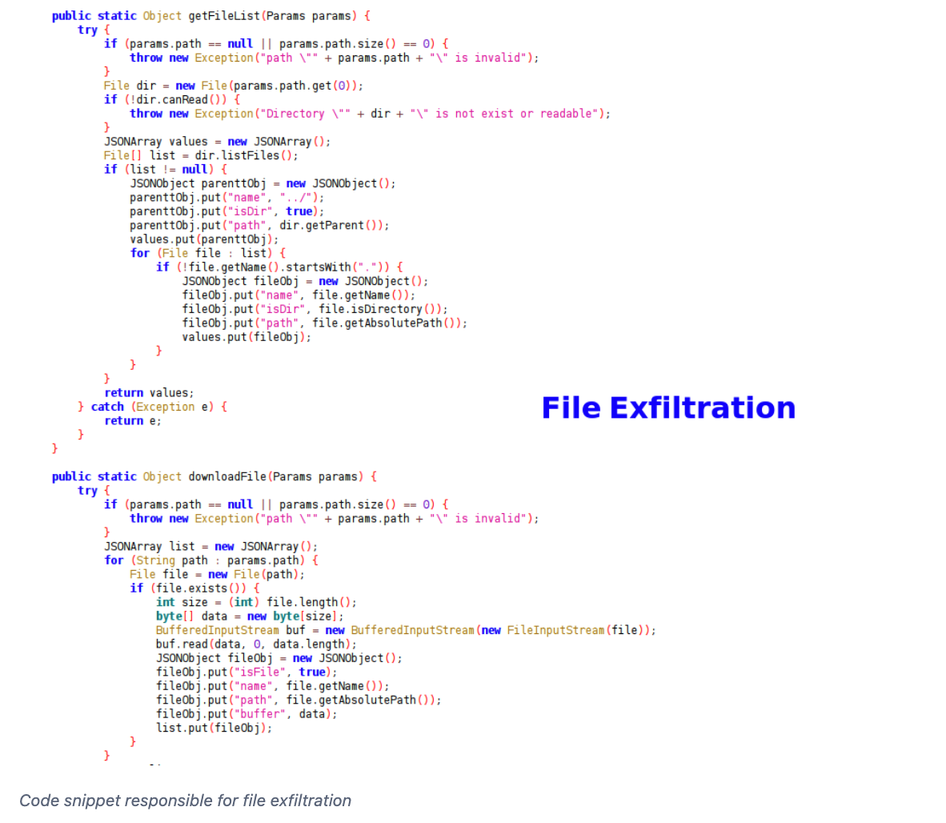
Daam Malware - File Exfiltration
The Daam malware can move through directories and exfiltrate any and all files from the victims device.
Notes:
The Daam malware can move through directories and exfiltrate any and all files from the victims device.

Slide 18
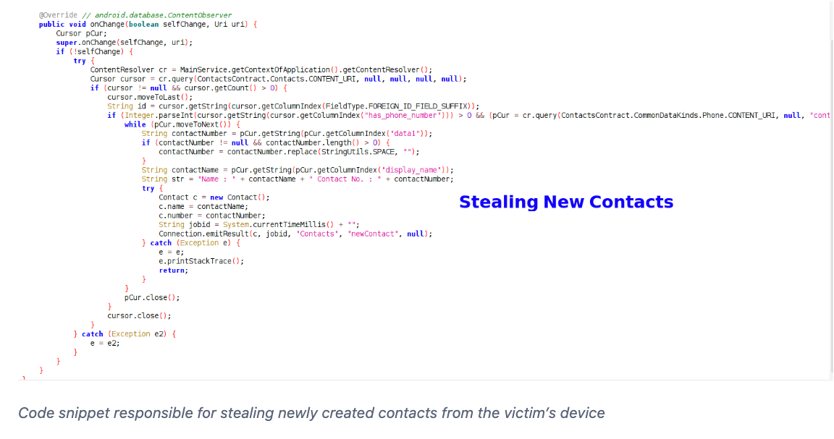
Daam Malware - Stealing Contacts
This malware is capable of both stealing previously created contacts and newly added contacts as well.
(3)
Notes:
This malware is capable of both stealing previously created contacts and newly added contacts as well.

Slide 19
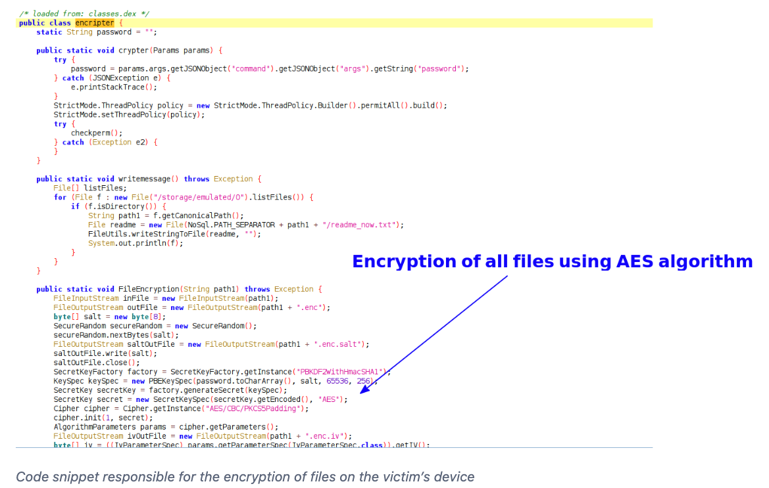
Daam Malware - File Encryption
Daam malware uses AES encryption algorithms to encrypt all files on the victims device without owners approval. After encryption the unencrypted files are deleted and only the encrypted files remain on the victims device.
(3)
Notes:
Daam malware uses AES encryption algorithms to encrypt all files on the victims device without owners approval. After encryption the unencrypted files are deleted and only the encrypted files remain on the victims device.

Slide 20
Daam Malware - File Encryption
“Interestingly, this malware was also observed to have ransomware capabilities since it encrypts the files using AES algorithms present in the root directory and SD card and drops a ‘readme_now.txt’ file.” (9)
(3)
Notes:
Interestingly, this malware was also observed to have ransomware capabilities since it encrypts the files using AES algorithms present in the root directory and SD card and drops a ‘readme_now.txt’ file. The readme_now file is a ransom note.
So, the DAAM malware is a troganized botnet that has spyware and ransomware capabilities

Slide 21
Daam Malware - Symptoms
Slow down in device running speed
System settings modified without victims consent
Suspicious applications appear
Data usage increases significantly
Battery usage increases significantly
Browsers are redirected to to suspicious websites - this malware can open phishing URLs
Intrusive advertisements (4)
Notes:
Slow down in device running speed
System settings modified without victims consent
Suspicious applications appear
Data usage increases significantly
Battery usage increases significantly
Browsers are redirected to to suspicious websites - this malware can open phishing URLs
Intrusive advertisements

Slide 22
Daam Malware - Damage
Stolen PII (messages, login credentials, calls, images, files, etc)
Decreased device performance
Decreased battery performance
Decreased internet speeds
Data loss
Financial loss
Stolen identity
Data encryption
Daam botnet can execute runtime code allowing attackers to continue other malicious activities (4)
Notes:
Stolen PII (messages, login credentials, calls, images, files, etc)
Decreased device performance
Decreased battery performance
Decreased internet speeds
Data loss
Financial loss
Stolen identity
Data encryption
Daam botnet can execute runtime code allowing attackers to continue other malicious activities

Slide 23
Daam Malware - Mitigation Strategies
Monitor device for symptoms and or scan device with a virus scanner
Install strong antivirus on the device to detect malicious signatures
Enable all Google Privacy Protection policies that stop and warn uses while downloading potentially malicious applications
Beware of applications asking for unusual permissions to operate
Exercise extreme caution when downloading applications from unknown sources.
Android could disallow application downloads from third party sources (4)
Android integrates security features on operating system and not just Google Play Portect (security feature in the app store). (11, 12)
Notes:
Monitor device for symptoms
Install strong antivirus on the device to detect malicious signatures
Enable all Google Privacy Protection policies that stop and warn uses while downloading potentially malicious applications
Beware of applications asking for unusual permissions to operate
Exercise extreme caution when downloading applications from unknown sources.
Android could disallows application downloads from third party sources
Android integrates security features on operating system and not just Google Play Portect (security feature in the app store). Doing this would be similar to what Iphones do. Where apple products are configured with security features integrated into the operating system, making them less susceptible to malware and other attacks. To engage in downloading not pre-approved apps on an apple product, the user must “jailbreak” their device.

Slide 24
Simple Virus Scanner

Slide 25
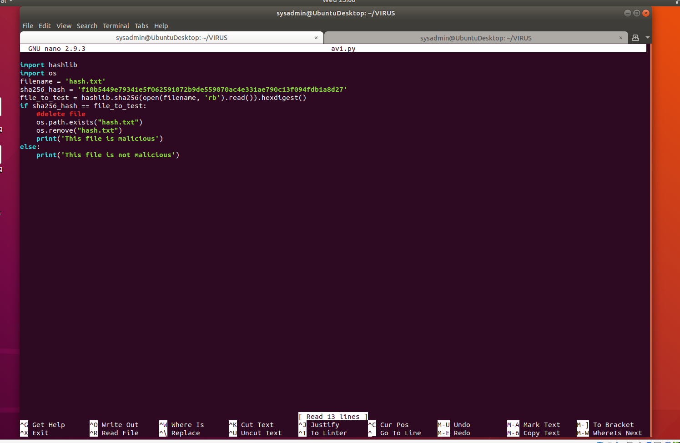
The Code
Notes:
This code is written in python and is a basic virus scanner.
Because we know some of the file hashes associated with DAAM malware, we can create a virus scanner to search for the virus on a device.
This is a mock scanner that could easily be configured to search for the specified DAAM malware hashes on a device. When the scanner detects the specified hashes it will send the user a message indicating whether the file is malicious or not and if the file is malicious, it will delete said file.
Theoretically you could program this scanner to look for any of the reported hashes in the IOC report

Slide 26

Virus Scanner Demonstration

Slide 27
References

Slide 28
References
1. GK Today. (n.d.). What is DAAM Malware? Retrieved from https://www.gktoday.in/what-is-daam-malware/#Encryption_Algorithm_and_File_Manipulation
2. WizCase. (2021, January 21). Android Malware DAAM: Data Theft & Ransomware Capabilities. Retrieved from https://www.wizcase.com/news/android-malware-daam-data-theft-ransomware-capabilities/#:~:text=The%20malware%20was%20first%20identified,infection%2C''%20noted%20CloudSEK.
3. CloudSEK. (n.d.). Malware Intelligence Analysis of DAAM Android Malware. Retrieved from https://cloudsek.com/threatintelligence/copy-of-malware-intelligence-analysis-of-daam-android-malware
4. PCRisk. (n.d.). Daam Botnet Android Malware Removal Guide. Retrieved from https://www.pcrisk.com/removal-guides/26531-daam-botnet-android
5. YouTube. (n.d.). DAAM Botnet Android Malware - Presentation. [Video]. Retrieved from https://youtu.be/YHSw04Z9q-I
6. Android Developers. (n.d.). MediaRecorder. Retrieved from https://developer.android.com/guide/topics/media/mediarecorder#:~:text=RECORD_AUDIO%20is%20considered%20a%20%22dangerous,remember%20and%20not%20ask%20again.
7. PCRisk. (n.d.). Daam Botnet Android Malware Removal Guide. Retrieved from https://www.pcrisk.com/removal-guides/26531-daam-botnet-android#:~:text=Psiphon%20is%20a%20popular%20app,includes%20the%20DAAM%20botnet%20malware.
8. Cyclonis. (n.d.). Remove DAAM Android Malware. Retrieved from https://www.cyclonis.com/remove-daam-android-malware/
9. CloudSEK. (n.d.). Malware Intelligence Analysis of DAAM Android Malware. Retrieved from https://www.cloudsek.com/threatintelligence/copy-of-malware-intelligence-analysis-of-daam-android-malware
10. Wikipedia. (2023, June 5). APK (File Format). In Wikipedia. Retrieved from https://en.wikipedia.org/wiki/Apk_(file_format)#:~:text=An%20APK%20file%20contains%20all,for%20being%20recognized%20as%20such.
11. MakeUseOf. (n.d.). What Is an APK File? Retrieved from https://www.makeuseof.com/tag/what-is-apk-file/
12. McAfee. (n.d.). Does an iPhone Need Antivirus Software? Retrieved from https://www.mcafee.com/learn/does-an-iphone-need-antivirus-software/#:~:text=Because%20of%20their%20shared%20operating,differently%20from%20most%20Android%20devices.

Slide 29
The End

